Slide 1

GAS LEAKAGE DETECTION WITH AUTOMATIC SHUT-OFF MECHANISM
Gas leakage incidents are the most hazardous forms of risk against human life, property, and the environment. In this project, an advanced gas leakage prevention system is designed to detect and mitigate hazardous gas leaks in an effective way.
This system integrates very sensitive gas sensors, microcontrollers, and real-time monitoring mechanisms to handle leaks promptly. Key components of this system include a gas sensor that will be able to detect flammable gases and indicate the presence of methane, propane, or LPG.
This will activate audible alarms as well as provide visible indicators for occupants in case of a leak.

Slide 2
PROBLEM & SOLUTION
PROBLEM
SOLUTION
1. Fire and Explosion Risk
Flammability: LPG is highly flammable. Even a small spark or static electricity can ignite a leak.
Explosion: If gas accumulates in an enclosed area and ignites, it can cause devastating explosions.
Damage to Gas Appliances: Leaks can harm burners, regulators, and hoses.
1. Early Detection and Warning
The gas sensor continuously monitors the air for LPG presence. If the concentration exceeds safe levels, the system triggers an alarm to alert you immediately.
2. Auto Shut-off of Gas Supply
The system activates the electromagnetic shutoff valve, automatically cutting off the gas supply when a leak is detected.

Slide 3



KEY FEATURES
Gas Sensors
Highly sensitive sensors [MQ-2] detect even minute gas leaks and transmit the signal to the indicators.
Indicators
Instant alarm [Buzzer] and LED indicators strikes when the gas leaks to notify the user.
Automatic Shut-Off
Instant alerts notify users and trigger the shut-off mechanism and the regulator turns off.

Slide 4
APPLICATIONS
Early Detection and Warning
Automatic Shutoff of Gas Supply
The gas sensor continuously monitors the air for LPG presence. If the concentration exceeds safe levels, the system triggers an alarm to alert you immediately.
The system activates the electromagnetic shutoff valve, automatically cutting off the gas supply when a leak is detected. This prevents the accumulation of gas, minimizing the risk of fire or explosion.
Notifications for Prompt Action
Preventive Safety
Advanced systems can send notifications to your smartphone or other connected devices, allowing you to respond even if you’re not at home.
The system reduces human error by automating the response to a gas leak.

Slide 5
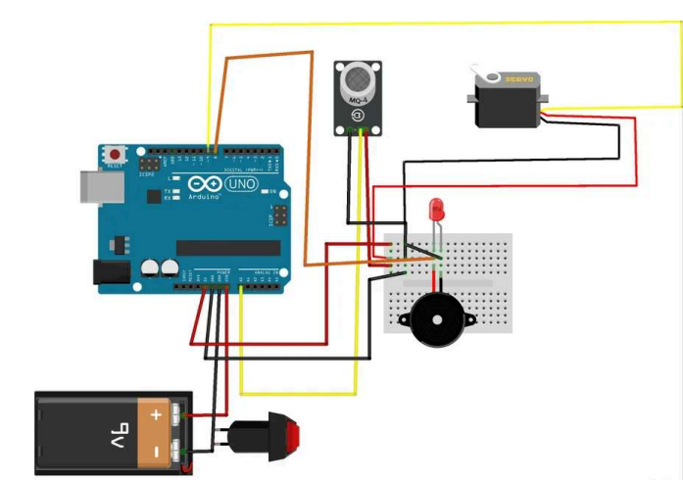

BLOCK & CIRCUIT DIAGRAM
This system uses an MQ-2 sensor to detect gas presence and sends signals to an Arduino microcontroller. Depending on the sensor reading, the Arduino activates a servo motor and triggers an LED and buzzer for alerts.
MQ-2
SENSOR
LED &
BUZZER
SERVO
MOTOR

Slide 6
Enhanced Safety
Prevents fire, explosion, and asphyxiation risks by quickly detecting and shutting off LPG leaks.
ADVANTAGES
Cost-Effective
Reduces gas wastage, lowers energy bills, prevents property damage, and may reduce insurance premiums.
Environmental Protection
Minimizes harmful gas emissions, energy consumption, and environmental pollution caused by leaks.

Slide 7
REAL-TIME EXAMPLES
Home Appliances
Smart Gas Leak Detectors: Sensors in kitchens immediately detect gas leaks and trigger automatic shutoff to prevent hazards.
Industrial Pipelines
Gas Stations
Real-Time Leak Detection: Pipelines are monitored for leaks, and automatic shutoff valves stop gas flow to prevent further damage.
Leak Prevention in Fuel Dispensers: Gas stations use automatic shutoff mechanisms to stop the flow of gas during a detected leak.

Slide 8
THANK YOU

